Slide 1

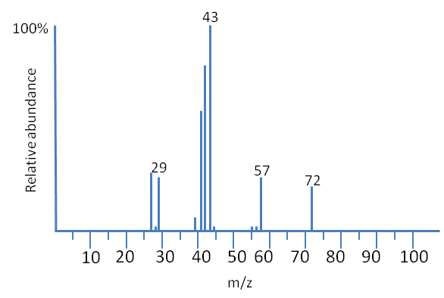
IMAGING MASS SPECTROMETRY Supervised By: Dr/ Noha
Represented By:
Mostafa Yehia Donia Abd Elslam
Renad Taher Mariem Ahmed
Ibrahim Elsayed

Slide 2

Today’s Agenda
01 INTRODUCTION
02 TECHNIQUES
03 INSTRUMENTATION
04 RESOLUTION
05 ARTIFACTS

Slide 3
INTRODUCTION

Slide 4

01: Mass Spectrometry-based Proteomics
METHODS
2-D gel
Liquid Chromatography
Capillary Electrophoresis
Molecular scanner gels
Capillary-Isoelectric Focusing
This universal technique analyzes complex protein samples.
It’s applied following isolation of the proteins from cell lysates by:
Biochemical Fractionation
Affinity Selection
Notes:
Notes to presenter:
What is your purpose for sharing this reflection?
Is it at the end of a unit or project?
Are you sharing this reflection, at the attainment of a learning goal you set for yourself?
Is it at the end of a course?
State your purpose for the reflection or even the purpose of the learning experience or learning goal. Be clear and be specific in stating your purpose.

Slide 5
TECHNIQUES

Slide 6

02: How The Spatial Information is Obtained?
MICROPROBE
The most common and the simplest technique.
MICROSCOPE
Microscope mode imaging uses ion-optical microscope elements to project the spatial origin of the ions onto a position-sensitive detector.
It can be described as position-correlated mass spectrometry.
It’s described in MALDI literature as Imaging Spectrometry Imaging (IMS).
It has a finite depth of vision, which makes sample preparation more critical.
Notes:
Notes to presenter:
Description of what you learned in your own words on one side.
Include information about the topic
Details about the topic will also be helpful here.
Tell the story of your learning experience. Just like a story there should always be a beginning, middle and an end.
On the other side, you can add a graphic that provides evidence of what you learned.
Feel free to use more than one slide to reflect upon your process. It also helps to add some video of your process.

Slide 7
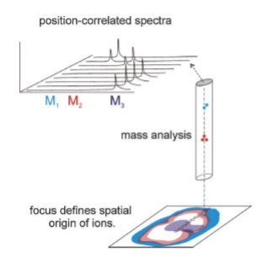
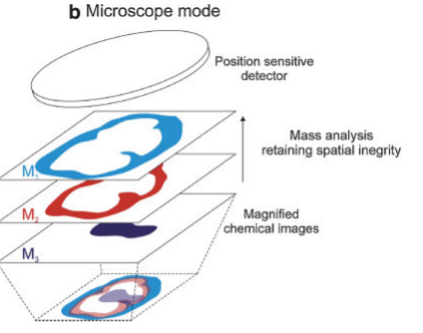

MICROPROBE vs MICROSCOPE
A focused ionization beam is used to analyze a small, localized region of the sample.
Spatial information is obtained from within the ionization spot.
Figure Above: Microprobe mode imaging records mass spectra from an array of designated positions to construct a molecular image.
Figure Above: Magnified images of mass resolved ion distributions are recorded with a 2D detector.
Notes:
Notes to presenter:
What did you think at first?
What obstacles did you encounter along the way?
How did you overcome those obstacles?
What images can you add to support your process?
This SmartArt allows you add images and text to help outline your process. If a picture is worth a thousand words, then pictures and words should help you communicate this reflection on learning perfectly! You can always click on Insert>SmartArt to change this graphic or select the graphic and click on the Design contextual menu to change the colors.
Feel free to use more than one slide to reflect upon your process. It also helps to add some video of your process.

Slide 8

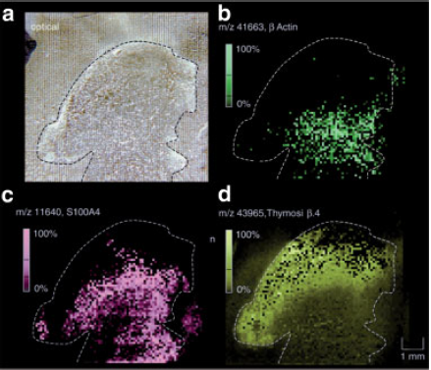
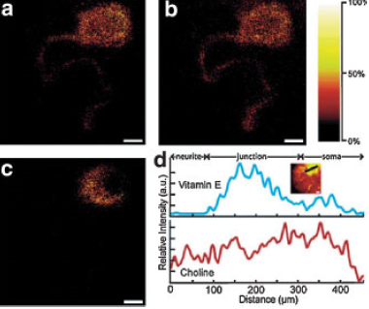
Introduction
Figures?
More Figures
Figure Above: Protein images from a glioblastoma section
Tissue section mounted on a metal plate, coated with matrix
Distribution of b Actin
Distribution of S100A4
Distribution of Thymosin b4 within the tissue section
Figure Above: Spatial Variation of the intensity of specific ions
Distribution of choline fragment (m/z = 86)
Distribution of acyl chain fragment (m/z = 69)
Variation of vitamin E using the molecular ion (m/z = 430)
Vitamin E is localized at the soma-neurite junction
Notes:
Notes to presenter:
What was important about this learning experience?
How is it relevant to your course, yourself, or your society or community?
Why is this significant?
This SmartArt allows you add images and text to help outline your process. If a picture is worth a thousand words, then pictures and words should help you communicate this reflection on learning perfectly! You can always click on Insert>SmartArt to change this graphic or select the graphic and click on the Design contextual menu to change the colors.

Slide 9
INSTRUMENTATION

Slide 10

03: INSTRUMENTATION – Ionization Mechanisms
Matrix-Assisted Laser Desorption/Ionization – (MALDI)
4
MALDI can record the spatial distribution of high mass molecules using the chemically specific molecular ions
It’s spatial resolutions are approximately 25 mm or more
3
2
Secondary Ion Mass Spectrometry – (SIMS)
1
SIMS is able to provide high spatial resolution images
It’s molecular ion mass range is much lower than that of MALDI
Notes:
Notes to presenter:
What steps will you be taking as a result of this learning experience?
Did you learn from any failed experiences? How will you do things differently?
What advice will you give to others so they can learn from your experiences?
How can you share what you learned with a real-world audience?
Some examples of next steps might be:
After delivering my first persuasive presentation, I am thinking about joining the debate team.
After making my first film, I’m considering entering it in our school film festival or local film festival.
After connecting with this career expert, I’d like to do some research on that career field because it sounds interesting to me.
This SmartArt allows you add images and text to help outline your process. If a picture is worth a thousand words, then pictures and words should help you communicate this reflection on learning perfectly! You can always click on Insert>SmartArt to change this graphic or select the graphic and click on the Design contextual menu to change the colors.
Feel free to use more than one slide to share your next steps. It also helps to add some video content to explain your message.

Slide 11
RESOLUTION

Slide 12
04: RESOLUTION
MASS RESOLUTION
LATERAL RESOLUTION
(SPATIAL RESOLUTION)
DEPTH RESOUTION

Slide 13
ARTIFACTS

Slide 14
05: ARTIFACTS
TOPOGRAPHY
MATRIX EFFECTS
ELECTRON DAMAGE

Slide 15

Let’s Analyze the Paper
MSI Review

